Slide 1



Lecture 2: History & State of Cybersecurity
COMP280: Creative Computing
BSc(Hons) Computing for Games
BA(Hons) Game Development: Programming

Slide 2
Learning outcomes
Understand how developments in social, technical , legal and economic spheres created an environment for cybersecurity
Define the term ‘cybersecurity’
Identify common hacking and phishing approaches

Slide 3
Understand how developments in social, technical , legal and economic spheres created an environment for cybersecurity

Slide 4
History of cybersecurity
Cybersecurity is a complex subject even it’s fairly short history
Makes sense to use analytical frameworks to help marshal our thinking

Slide 5
History of cybersecurity
5Ws & H (6Ws)
Who, where, why, what, when & how
6 questions to think about complex situations from different perspectives
Take a complex problem
Break it down into smaller ones to understand it better
Combine them back together to demonstrate your mastery of the problem space

Slide 6
History of cybersecurity
3As (UML use case collaborations)
Actors (agents)
Activities
Artefacts (things that are produced and consumed by activities and agents)
Again, break complex problems down into things that make sense and re-combine in a way that makes sense to you
https://app.pluralsight.com/library/courses/uml-introduction/table-of-contents

Slide 7
History of cybersecurity
Macroeconomic analysis (STEP / PEST / PESTLE)
A way of looking at change through various lenses
Social (societal), technical, economic, political & (environmental & legal)
Again, take complex situations
split them into their parts to analyse
Rebuild the narrative so it makes sense

Slide 8
History of cybersecurity
Once upon a time there was no ‘the internet’
Computers were standalone & single function
Users had dumb terminals
There was no inter- connectivity

Slide 9
History of cybersecurity
Once upon a time there was no ‘the internet’
However, hacking and phishing did exist
Hacking (Enigma machine and other government ciphers)
Political espionage (Watergate scandal)
Industrial espionage (Operation Brunnhilde)
Dumpster diving (every PI ever)
Disgruntled employees (Shawshank Redemption)
‘Information’ has value
Protected by laws
Legal protections can occur too late …

Slide 10
History of cybersecurity
Growth of information technology over the last 50 years:
The internet
The WWW
Moore’s Law
Number of transistors in a circuit doubles every two years
Massive growth of technology complexity
Massive reductions in prices
Reduction in barriers to entry for technology
Move towards software as a service (SaaS)
Companies can rent rather than buy/build technology
Creation of technology—based companies
FANG companies (facebook, Apple, Netflix, Google)

Slide 11
History of cybersecurity
https://www.economist.com/leaders/2017/05/06/the-worlds-most-valuable-resource-is-no-longer-oil-but-data

Slide 12
Define the term ‘cybersecurity’

Slide 13
Cybersecurity
We can see that cybersecurity relates to:
Unauthorised access to an organisation’s information and/or systems
Making information and/or systems unavailable to an organisation
Tampering with an organisation’s information and/or systems
I.e. systems and information suffering from some form of loss and/or harm

Slide 14
Cybersecurity
We can define harm as:
Reputational damage
Financial loss
Regulatory
Operational
Loss of Intellectual Property (IP), trade secrets etc

Slide 15
Cybersecurity
A definition of cyber security:
Cybersecurity is protecting the confidentiality, integrity & availability of an organisation’s information assets from malicious actors and/or accidents.

Slide 16
Cybersecurity
Who are these actors?
Depends on your organisation
Criminals, Competitors, Countries
Hackivists & Hackers

Slide 17
Cybersecurity
Cyber Risk Assessments
Use risk modelling to work out likelihood and impact
Then plan accordingly
Criminals
Probability of Attack
Competitors
Hackers
Impact to organisation

Slide 18
Cybersecurity
Cyber Risk Assessments
Scenario | Likely threat actors
I run a leading crypto currency wallet service. We have over a billion bitcoin hashes.
I run the IT department for the world’s leading soft drinks beverage with our famous, and secret, recipe
I run a completely legitimate nuclear research facility in Iran
I run a completely legitimate nationalist website
I run the Apple Store

Slide 19
Cybersecurity
Cyber Risk Assessments
Scenario | Likely threat actors
I run a leading crypto currency wallet service. We have over a billion bitcoin hashes. | Criminals
I run the IT department for the world’s leading soft drinks beverage with our famous, and secret, recipe | Competitors
I run a completely legitimate nuclear research facility in Iran | Countries
I run a completely legitimate nationalist website | Hacktivists
I run the Apple Store | Hackers

Slide 20
Identify common hacking and phishing approaches

Slide 21
Common hacking and phishing approaches
Let’s define some terms
Hacking is ‘attacking’ a system through a computer
Phishing is ‘attacking’ a system through people (employers, employees, contractors, users etc)

Slide 22
Common hacking and phishing approaches
Hacking
Exploits & Vulnerabilities
Relies on implicit weaknesses within hardware, operating systems, applications
Admin / default accounts on switches / moderns, servers etc
Buffer over-runs
Backdoors in applications
Known bugs in systems
See this a lot with video games, in particular with speed runs ;)
This is why we have so many patches and updates now

Slide 23
Common hacking and phishing approaches
Hacking
Cross-site scripting
Inject client-side scripts into web pages
See this a lot with emails that have dubious links
Javascript in the links will attempt to copy user credentials in cookies
https://www.veracode.com/security/xss

Slide 24
Common hacking and phishing approaches
Hacking
SQL Injections

Slide 25
Common hacking and phishing approaches
Hacking
SQL Injections
Client server communications on HTTP will often encode data into urls
You can see this with all the %whatever?stuff% you see in urls in the browser
These are unpacked by the server and used to run server-side scripts
Often, developers will send raw SQL commands that are not sanitised on the server
DROP TABLE * will delete all the tables in a database
PySQL traps this behaviour ;)
You should think about encrypting server bound data & commands

Slide 26
Common hacking and phishing approaches
Hacking
Packet sniffing / Man in the middle
Network data follows a defined format (otherwise no-one would be able to read it)
You can sniff packets to see their contents
Often, services will use raw text for data (see previous slide)
This is v.bad if the service is sending raw passwords to the server (this is frighteningly common)
A man in the middle is a node that will read network packets before sending them on to their correct destination
Daily Mail ‘Café Wifi’ concerns.
HTTPS is secure HTTP
You can encrypt packet payloads and sequence them to stop replay attacks

Slide 27
Common hacking and phishing approaches
Phishing
Email phishing
‘Nigerian prince’ / assistance scams
Fake company log-on scams
You need to log on to some service to for some reason
Bank, paypal, ebay, apple etc

Slide 28
Common hacking and phishing approaches
Phishing
Voice phishing
Call up employees in a company asking for account details
‘Hi this is Dave in accounts, we’re having problems doing <some work> with your department's data, can you send over your finance account details so we can sort it out as we can’t get through to IT and this needs to be done by the end of the day’
Can do it with email & spoofed addresses
It’s a bit of a modern take on the old scam of sending companies bills for non-existent services
Or the zoo parking warden

Slide 29
Common hacking and phishing approaches
Phishing
Spear phishing
This is a derivative of phishing where the phishers look to target their victims using available company data

Slide 30
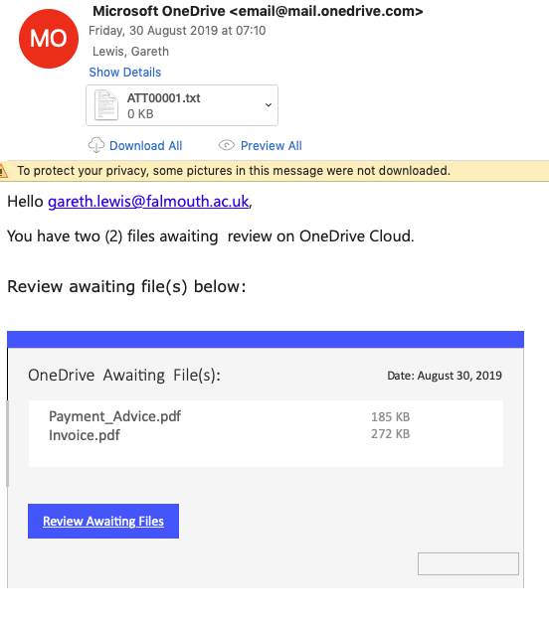
Common hacking and phishing approaches
Phishing
Spear phishing
This is a derivative of phishing where the phishers look to target their victims using available company data

Slide 31
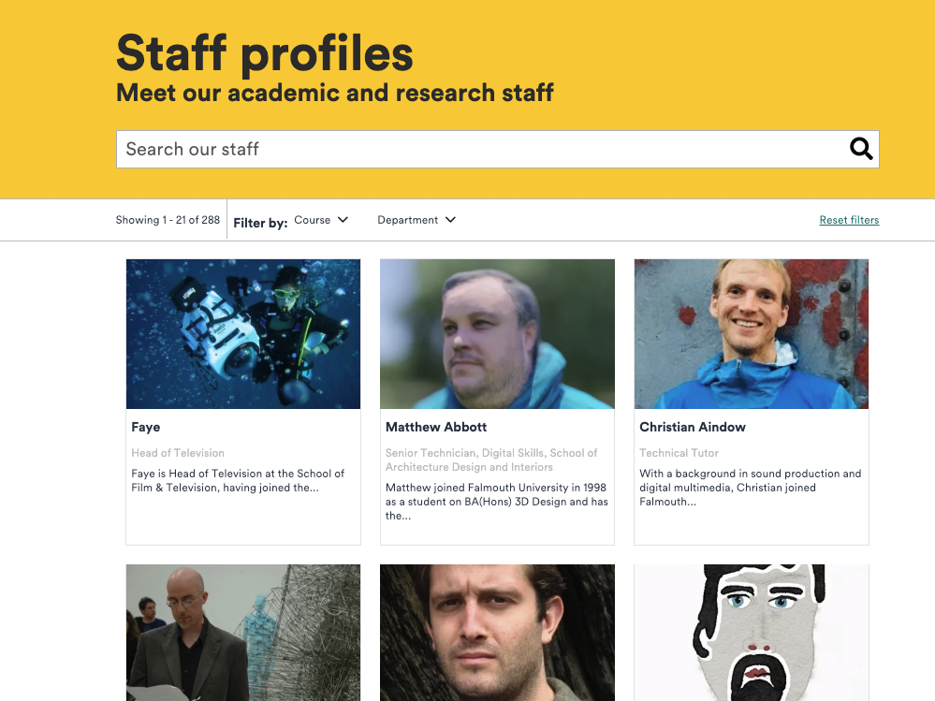
Common hacking and phishing approaches
Phishing
Whaling
This is another derivative of phishing where the phishers look to target senior managers in a company.
These approaches can be easy when companies have fat websites with lots of social data on them

Slide 32
Wrap-up
Data is the new oil, it is the world’s most valuable resource
Therefore, there’s value to be had in having it, especially if it’s not yours
There’s value to be had in keeping yours secure
Nothing changes in human nature, we just change the artefacts that we apply our activities to
Phishers will always phish
People will always want information
People and organisation will always want to keep their information private

Slide 33
Wrap-up
Understand how developments in social, technical , legal and economic spheres created an environment for cybersecurity
Technology has created new ways to store, share and process data
This has created new industries and societal demands for data-centric businesses
Information always has value

Slide 34
Wrap-up
Define the term ‘cybersecurity’
Cybersecurity is protecting the confidentiality, integrity & availability of an organisation’s information assets from malicious actors and/or accidents.
Breaches in cybersecurity will impact an organisation’s:
Reputation
Finances
Operational ability
Secrets (IP)
Position in within regulatory frameworks
Cyber criminals can be
Criminals, competitors, countries, hacktivists & hackers

Slide 35
Wrap-up
Identify common hacking and phishing approaches
Hacking generally involves compromising computers
Phishing generally involves compromising people
Hacking
Exploits & vulnerabilities, cross-site scripting, SQL injections, man-in-the-middle
Phishing
Email, voice, spear & whaling

Slide 36
Questions

